Slide 1
DataPower deep dive and exploration : IBM Garage

Slide 2
AGENDA
Overview DataPower Containers.
Key Features of datapower on docker.
Datapower options on docker.
Datapower Deployment Options.
Datapower docker demo
Datapower on Openshift
Datapower Service Custom Resource

Slide 3
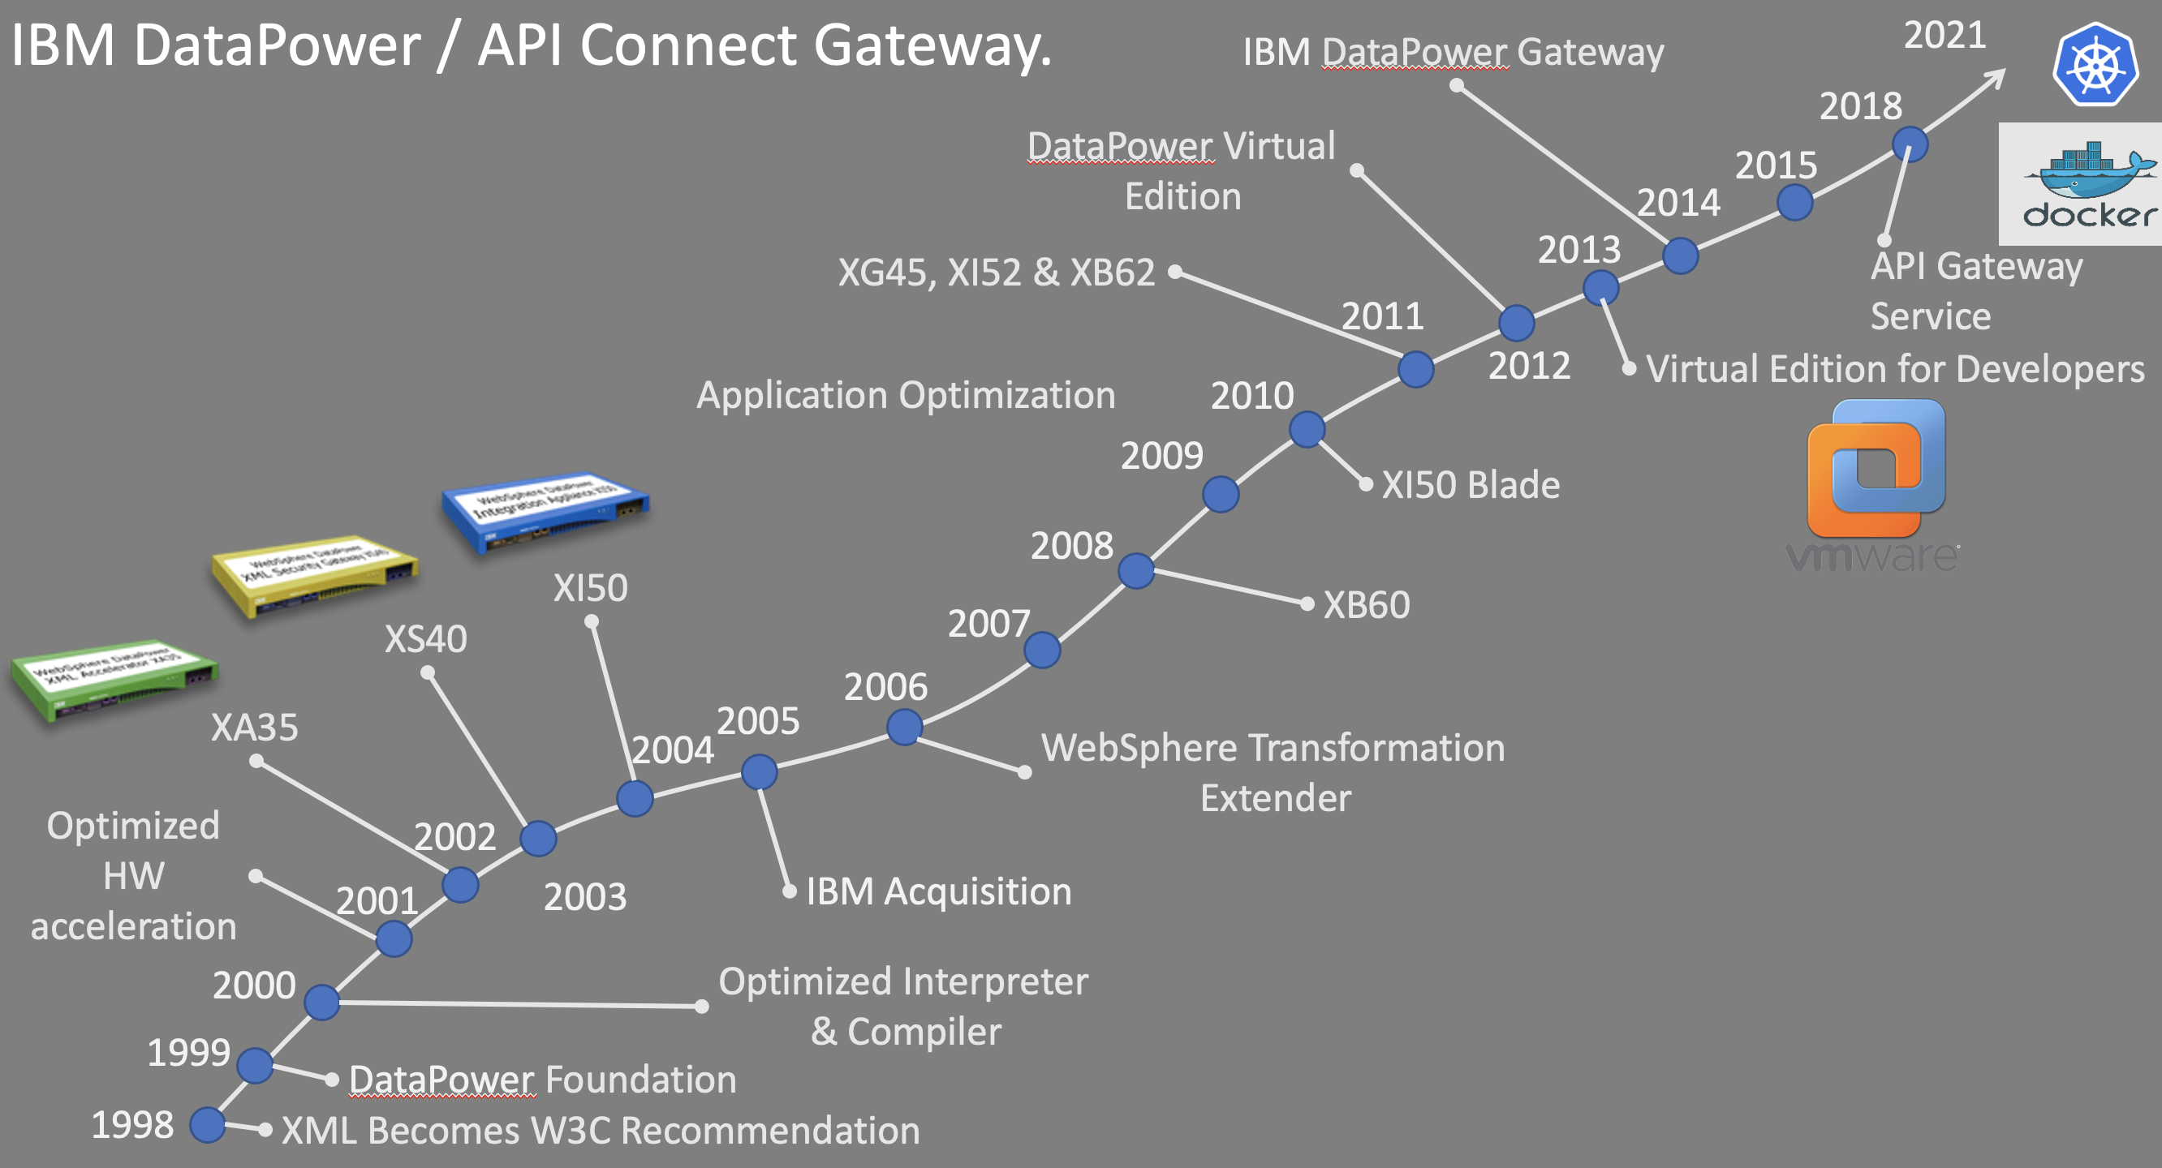


Slide 4
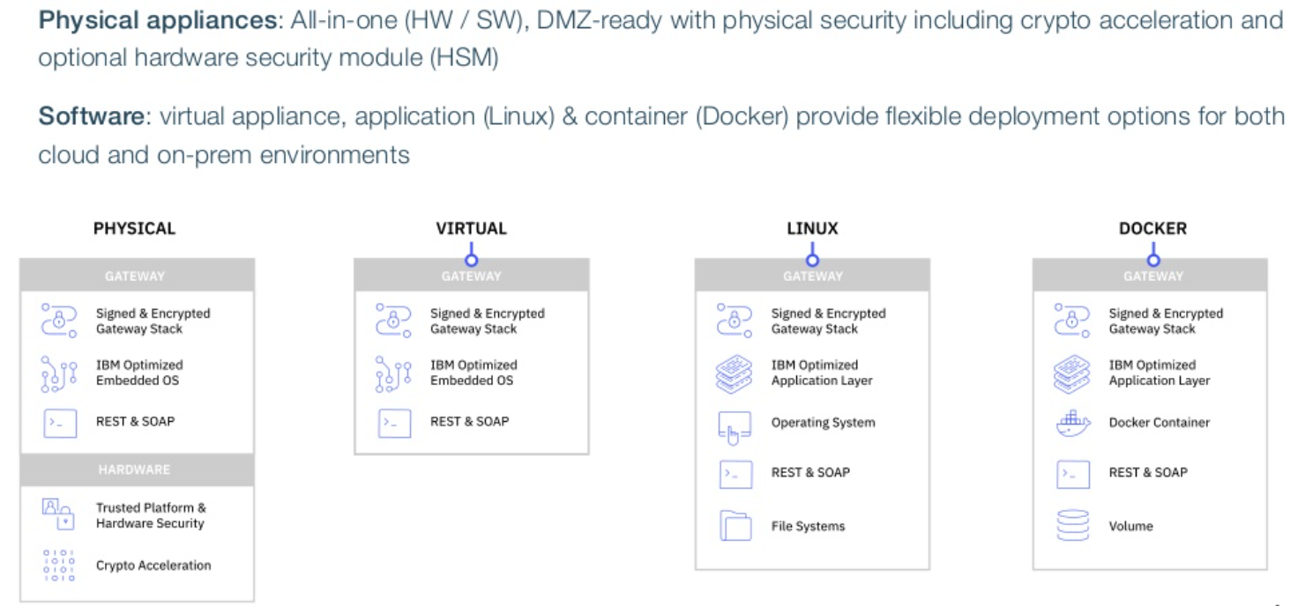
Datapower : Can be deployed everywhere

Slide 5
Datapower : Env Variables
Environment variable | drouter argument | Description
DATAPOWER_ACCEPT_LICENSE | --accept-license | Indicates acceptance of the terms of the license agreements.
DATAPOWER_INTERACTIVE | -i --interactive --no-interactive | Enables access to the DataPower Gateway CLI on stdin at start.
DATAPOWER_LOG_STDOUT | -n --log-stdout --no-log-stdout | Directs the default log to stdout. You can use the docker logs command to show the default log. In IBM-provided Docker images, DATAPOWER_LOG_STDOUT=true.
DATAPOWER_SHOW_LICENSE | --show-license | Shows the terms of the license agreements in English.
DATAPOWER_SYSTEM_INFO | --system-info | Shows more detailed information about DataPower Gateway in XML format and exits.
DATAPOWER_VERSION | -V --version | Shows the version and build information about the DataPower Gateway and exits.
DATAPOWER_WORKER_THREADS | -t --worker-threads | Sets the number of worker threads to allocate to the main process. When not specified, one worker thread is used for each CPU. The best practice is to set a value that is less than the number of CPUs on your host.
https://www.ibm.com/docs/en/datapower-gateways/10.0.1?topic=docker-creating-datapower-application

Slide 6
Datapower : File System
DataPower directory | Container directory
config:/// | /opt/ibm/datapower/drouter/config
local:/// | /opt/ibm/datapower/drouter/local
Certs:/// | /opt/ibm/datapower/root/secure/usrcerts
Sharedcerts:/// | /opt/ibm/datapower/root/secure/sharedcerts
https://www.ibm.com/docs/en/datapower-gateways/2018.4?topic=virtual-datapower-gateway-docker

Slide 7
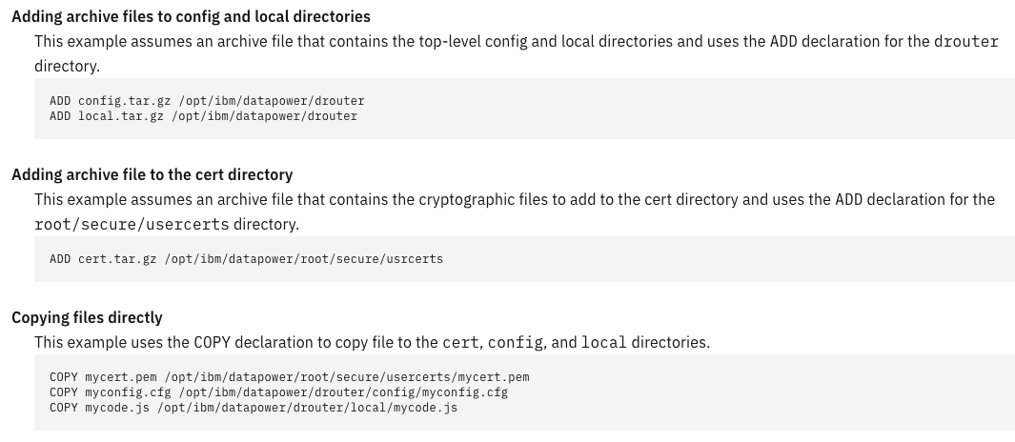
Datapower : Adding custom files

Slide 8
Datapower : Webui
Once the Datapower container is running, you can enable the webui of the datapower instance. By default, webui is disabled
Docker attach <container_id>
Run the below commands on the terminal
#configure terminal
# web-mgmt
# admin-state "enabled”
# exit

Slide 9
Docker : Option 1
1. Run Datapower with volumes( -v) . This option mounts the file system as volumes from the host and mounts it into the container during runtime.
COMMAND :
docker run -it –-name datapower \ -v $(pwd)/config:/opt/ibm/datapower/drouter/config \ -v $(pwd)/local:/opt/ibm/datapower/drouter/local \ -v $(pwd)/certs:/opt/ibm/datapower/root/secure/usrcerts \ -e DATAPOWER_ACCEPT_LICENSE="true" \ -e DATAPOWER_INTERACTIVE="true" \ -p 9090:9090 \ tag
https://www.ibm.com/docs/en/datapower-gateways/10.0.1?topic=docker-creating-datapower-application

Slide 10
Docker : Option 2
Run Datapower as an immutable image.
Once the service is developed and the config, local and certs folders are available build a docker image with all the necessary files and configs inbuilt .
COMMAND : Create a dockerfile
FROM ibmcom/datapower:latest
COPY config /opt/ibm/datapower/drouter/config
COPY local /opt/ibm/datapower/drouter/local
COPY certs /opt/ibm/datapower/root/secure/usrcerts
USER root
RUN chown -R drouter:root /opt/ibm/datapower/drouter/config \ /opt/ibm/datapower/drouter/local \ /opt/ibm/datapower/root/secure/usrcerts
RUN set-user drouter
USER drouter
COMMAND : docker build . -f Dockerfile -t my-image

Slide 11
Datapower : Deployment Methods
Using config maps and volumes : There will be 3 main config maps
Config : holds the services and domain configuration
Local : holds the local file system under datapower file management
Certs : for the certs and key that are used in services.
Using immutable object: If using immutable object, all the config , file system (local) and certs are pre-configured can be pulled from source control. Changes need to be done, local changes will first take place. A new docker image is built as an immutable copy. This can be then deployed as a new image and tested, and then can be used to change the image config of the existing deployment. The benefit of this approach is easier roll back as the change of the image version will revert to the changes.
Using persistent volumes : Any changes done on a single datapower instance will be local and persisted.

Slide 12
Datapower : Add On Features
You can activate modules in only the production edition.
Snippet for Dockerfile
USER root
...
ADD idg_dk-activate-IM-date.tar.gz /opt/ibm/datapower ...
RUN set-user drouter
USER drouter
You can de-activate modules in only the non-production edition.
Snippet for Dockerfile
USER root
...
RUN disable-feature appopt b2b
...
RUN set-user drouter
USER drouter

Slide 13
Demo, getting started
Summary:
1. Using on Docker playground labs
2. Accessing an endpoint on docker playground.
3. Running a datapower image.

Slide 14
Resources to get started with DataPower on Containers
IBM Integration Community
Container on Docker Hub
More tutorials on GitHub
Cloud Pak For Integration Documentation
Technotes, recommended way of config management
Automate Integration: https://www.ibm.com/cloud/cloud-pak-for-integration Integration Community: https://ibm.biz/BdfRNK Integration Products Home: https://www.ibm.com/cloud/integration

Slide 15
DataPower deep dive and exploration : Openshift IBM Garage

Slide 16

IBM Cloud Pak for Integration
Client and Partner Applications
Unified User Experience
Asset Sharing
API Lifecycle
Application &
Data Integration
Enterprise
Messaging
Events
High Speed
Transfer
Governance
API Connect
App Connect Enterprise
MQ
Event Streams
(Kafka)
Aspera
Integration Security
DataPower
IBM containerized software
Container platform and operational services
IBM public cloud
AWS
Microsoft Azure
Google Cloud
Private
IBM Z IBM LinuxOne IBM Power Systems IBM Storage
Endpoints
Note: Capabilities can be deployed outside of containers as well
Notes:
So today we are looking at the App Connect Enterprise component, which provides the Application and Data Integration capabilities to the Cloud Pak for Integration.

Slide 17
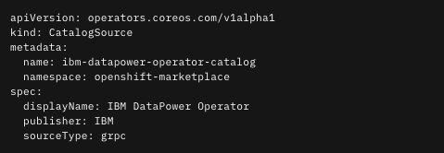
DataPower : Catalog Source
To enable the installation of the DataPower Operator, a CatalogSource must be created in the openshift-marketplace.

Slide 18
An Operator is a method of packaging, deploying and managing a Kubernetes-native application.
A Kubernetes-native application is an application that is both deployed on Kubernetes and managed using the Kubernetes APIs and kubectl tooling.
Using operators provides repeatability of installation and allows easy upgrade.
What is an Operator?
Notes:
The goal of an Operator is to put operational knowledge into software. Previously this knowledge only resided in the minds of administrators, various combinations of shell scripts or automation software like Ansible. It was outside of your Kubernetes cluster and hard to integrate.
Operators implement and automate common Day-1 (installation, configuration, etc) and Day-2 (re-configuration, update, backup, failover, restore, etc.) activities in a piece of software running inside your Kubernetes cluster, by integrating natively with Kubernetes concepts and APIs. We call this a Kubernetes-native application. With Operators you can stop treating an application as a collection of primitives like Pods, Deployments, Services or ConfigMaps, but instead as a single object that only exposes the knobs that make sense for the application.
-----
Kubernetes Operators manage every component of the Cloud Pak for Integration, enabling the Cloud Pak to be entirely Kubernetes native, and OpenShift® native. This enables automation at every level of the stack, including the platform itself and the applications that are built on the platform.
Support for Operators as a method for deploying Cloud Pak for Integration replaces the use of Helm. The use of Operators with Cloud Pak for Integration can improve responsiveness and help achieve consistent outcomes.
-----
Operators simplify the packaging, deployment, management, and updating of DataPower Cloud Pak on the Red Hat® OpenShift Container Platform.
Operators on the other hand, provide many benefits:
Repeatability of installation and upgrade
Over-the-air updates for OpenShift components
Deployment of the Cloud Pak into Kubernetes according to best practices from product development

Slide 19
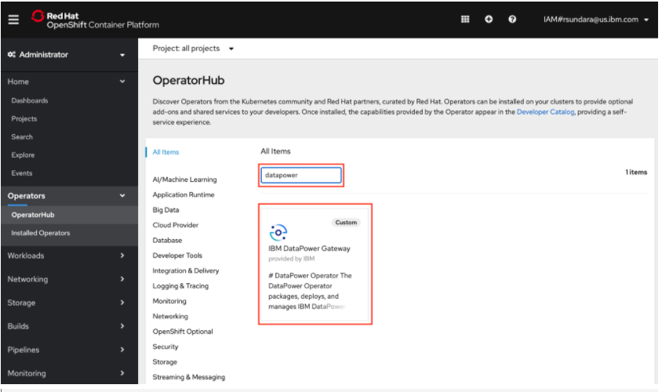
DataPower Operator on Operator Hub

Slide 20
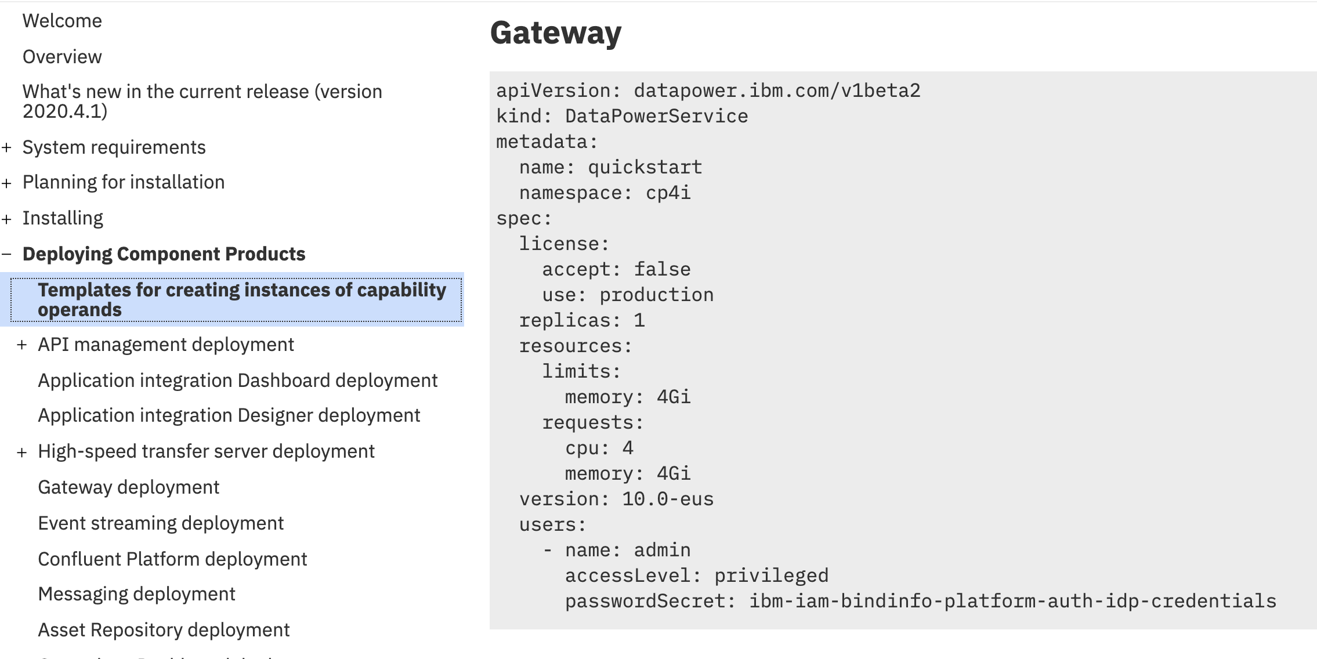
Getting started with DataPowerService Operator
https://www.ibm.com/support/knowledgecenter/en/SSGT7J_20.4/install/install_templates.html
Notes:
Template of the object type DataPowerService from documentation on Knowledgecenter.
By default
Datapower is deployed as an ephemeral system .
Webui and other interfaces are not exposed.

Slide 21
DataPower: Custom Resource Definition
License :
accept: must be boolean true for the DataPower pod(s) to start successfully.
This property directly sets the DataPower DATAPOWER_LICENSE_ACCEPT environment variable in pods,
which acknowledges the license acceptance.
use: the license use. Can be one of the following values:
production
nonproduction
developers
developers-limited
license: the license ID

Slide 22
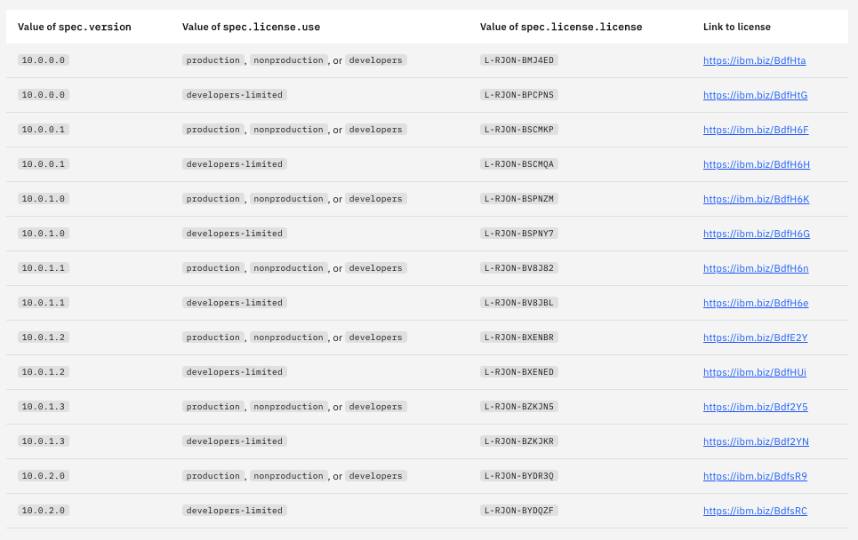
Current Licenses :

Slide 23
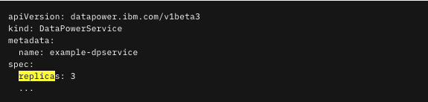
DataPower: Custom Resource Definition
Replicas :
The replicas property is an integer that directly sets the replicas field on the StatefulSet of DataPower pods.
This property sets the number of DataPower pods you wish to deploy.
Example:

Slide 24
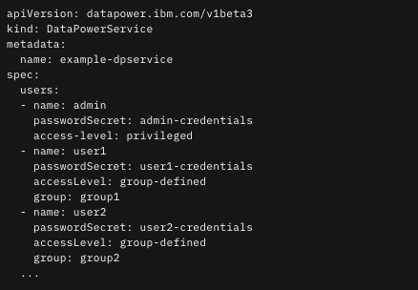
DataPower: Custom Resource Definition
Users :
An admin account must be defined. By default, an admin account is defined using the secret name admin-credentials.
Oc create secret generic admin-credentials --from-literal=password=passw0rd#
Notes:
The following are values in the secret which can be used to define the user’s credentials:
password-hashed: The hashed value (see Linux man 3 crypt for format) of the user’s password. Required if password is not defined.
password: The user’s password. Required if password-hashed is not defined; ignored if password-hashed is defined.
salt: The salt value used when hashing password (see man 3 crypt). Optional; ignored when password-hashed is defined. (Default: 12345678)
method: The name of the hashing algorithm used to hash password. Valid options: md5, sha256. Optional; ignored when password-hashed is defined. (Default: md5)

Slide 25
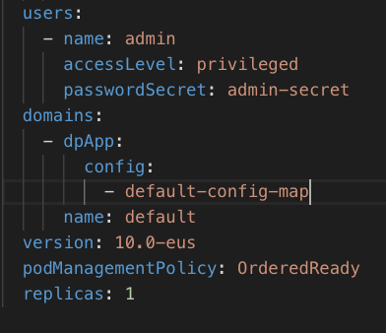
DataPower: Custom Resource Definition
Default Domain :
The domains property allows for user-provided domain configuration(s) to be injected into the DataPower pods at runtime, prior to the DataPower process starting.
For default domain, a separate config map will be created that will have the resources and service configuration.
For example : poc domain
default-config-map
default-certs-secret
Notes:
Set the below cfg file web-mgmt.cfg to update the configurations
web-mgmt
admin-state enabled
local-address 0.0.0.0
port 9090
save-config-overwrite
idle-timeout 9000
ssl-config-type server
exit

Slide 26
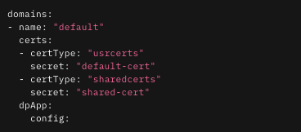
DataPower: Custom Resource Definition
Domain : Certs
Certs
certs is a list of all certificate, key, or general crypto files that need to be dropped into a Domain. There are two fields for each item in the certs list:
CertType:
Defines the type of cert.
Secret
Defines the name of the Kubernetes or OpenShift secret containing the crypto files. This secret can contain any number of certificates.
SubPath
Defines the SubPath to place the cert into. Only allowed if certType is usrcerts. This is a relative path, and will be appended to the domain’s directory path An example would be dir1/dir2.
The following snippet of the DataPowerService Custom Resource. The name field is just that: the name of the domain. This will propagate into the pod and be the name of the resultant DataPower Domain.
kubectl create secret generic <my-crypto-secret> --from-file=/path/to/cert --from-file=/path/to/key

Slide 27
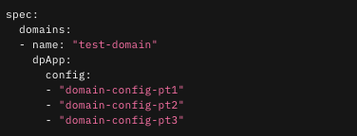
DataPower: Custom Resource Definition
Domain Config : dpApp
is a basic configuration method for the DataPower operand.
It takes two ConfigMap arrays:
config
Array of ConfigMaps containing DataPower configuration file(s).
At least one ConfigMap must be provided for config.
Each ConfigMap specified in config must be a ConfigMap created directly from standard DataPower config file(s).
oc create configmap domain-config --from-file=/path/to/IDP.cfg –from-file= /cfg2.cfg

Slide 28
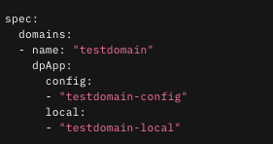
DataPower: Custom Resource Definition
Domain Config : dpApp
is a basic configuration method for the DataPower operand.
It takes two ConfigMap arrays:
Local
Array of ConfigMaps each containing a tarball of local files to be used by the Domain.
This value is optional.
Each ConfigMap specified in local must be a ConfigMap created from a tarball containing local files for the Domain.
tar --directory=/path/to/testdomain/local -czvf testdomain-local.tar.gz .
kubectl create configmap domain-local --from-file=/path/to/domain-local.tar.gz

Slide 29
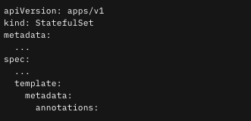
DataPower: Domain Updates
Domains are comprised of ConfigMaps and Secrets that exist in the cluster.
It is expected that over time a Domain configuration will need to be updated, including the config and local ConfigMaps and Secrets that comprise the serts for the Domain.
These ConfigMaps and Secrets can be updated in-place in the cluster, and the DataPower Operator will automatically reconcile those changes.
When an update is detected on a ConfigMap or Secret referenced by a Domain, a rolling update is triggered across the Pods in the StatefulSet. This allows for Domains to be updated without modifying the DataPowerService Custom Resource directly.

Slide 30
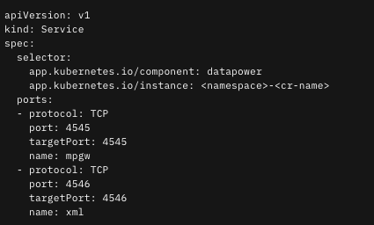
DataPower: Exposing a Service
In your Service, you will specify the Ports you want exposed to the Internet. These ports are entirely dependent on your DataPower configuration. To link the Service to your cluster of DataPowers, you will need to provide the correct label selectors.
Example : In your service, you will need to specify each port that needs to be exposed to the internet. For example, if a Multi-Protocol Gateway is exposed on port 4545 and an XML Firewall application exposed on 4546, your Service might look like:

Slide 31
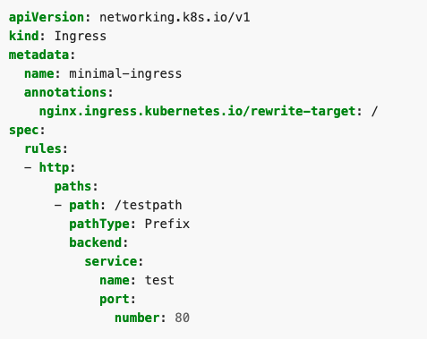
DataPower: Exposing a Service outside the cluster
There are 2 options that you could chose to expose the service :
Openshift Route:
This will allow each route to be mapped to a service endpoint/port. With this there will be unique domain names created which will allow users to identify the endpoint.
Openshift Ingress:
An ingress resource is created that will forward the traffic to the datapower cluster based on the uri. This will have a common domain service name .
Notes:
Industry Experience :
Openshift Route :
Clients Concerns:
- Too many domain service names to be shared to the client, and hence some clients have created an ingress resource to enable common domain name
Openshift Ingress:
https://kubernetes.io/docs/concepts/services-networking/ingress/
Tls management is not as straight forward as it is for openshift route, and hence changing default timeout settings of the openshift router becomes challenging to maintain.
Yaml
apiVersion: networking.k8s.io/v1 kind: Ingress metadata: name: minimal-ingress annotations: nginx.ingress.kubernetes.io/rewrite-target: / spec: rules: - http: paths: - path: /testpath pathType: Prefix backend: service: name: test port: number: 80

Slide 32
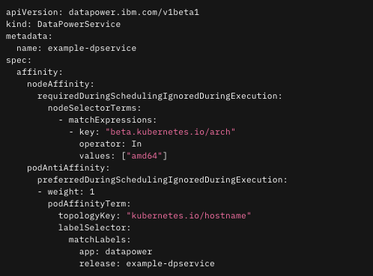
DataPower: Affinity
When running datapower we need to consider the high availability aspects of running.
When running an openshift cluster , the nodes are labelled to provide availability zones. Using these availability zones and labels we can force openshift to deploy the datapower replicas to ensure high availability

Slide 33
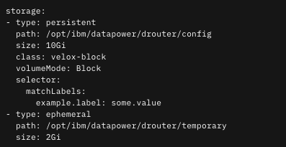
DataPower: Persistent Storage
Storage definitions fall into two categories: ephermeral and persistent. For persistent storage definitions, the Persistent Volume must use an access mode of ReadWriteOnce.
This only applies when the storage type is persistent.
Any changes done on one datapower instance is not replicated to the other instance.
Each pod will be using the storage with read mode – read write once
Notes:
path
path is simply the path internal to the container to persist. The path also informs the names of the volume resources to ensure uniqueness.
This field applies to both ephemeral and persistent types.
size
size is the size of the persisted volume. The expected format is some form of #Gi. For more information on resource definitions, see Resources doc.
This field applies to both ephermeral and persistent types.
class
class is a direct pass through to the storageClassName field for the Persistent Volume Claim. It determines which class to use for the volume. StorageClass doc
This field applies only to the persistent type.
volumeMode
volumeMode is a switch between Filesystem and Block volume types. Our default type is Filesystem. VolumeMode doc
This field applies only to the persistent type.
selector
selector is a set of label selectors to refine the search for a Persistent Volume to bind.
This field applies only to the persistent type.
deleteClaim
deleteClaim is a boolean value to specify whether a persistent volume claim should be deleted or retained.

Slide 34
34

